Slide 1
Financial Health of Eye Care Practices
John Hoff
Ivy Li
Chakradhar Thota
Huy Tran
Duy Van

Slide 2

Introduction and Research Question
By 2015, in the United States, myopia (nearsightedness) rates have almost doubled among the millennials.
How can we help eye care practices understand their financial health, so they can be sustainable while providing high quality services?
Source: https://expand.openviewpartners.com/

Slide 3
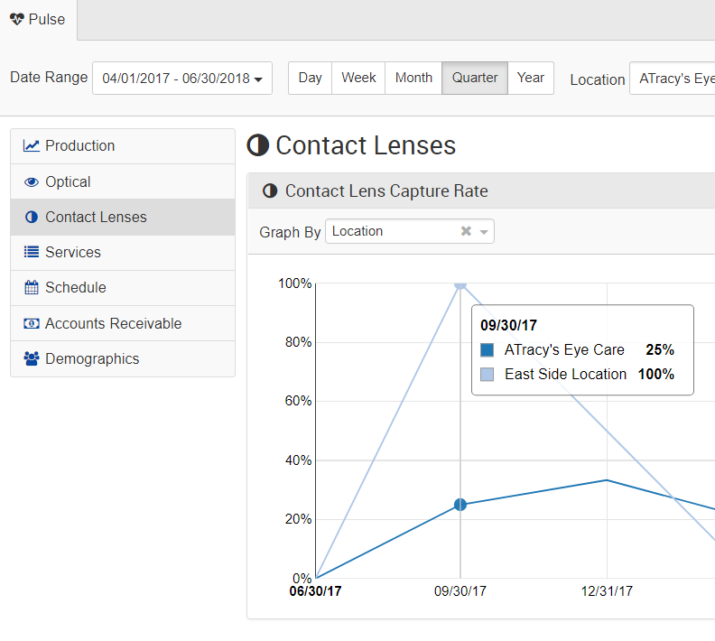
Data Source
Performance metrics of Eye Care practices using RevolutionEHR
16 key indicators aggregated by quarter during 2016 and 2017
9000 quarterly samples containing 11.7 million patient visits
Individual indicators are presented in a web portal to RevolutionEHR users.

Slide 4
Data Cleaning and Transforming
Keeping Sales’ and Receipts’ amounts that are greater than zero
Several of the count variables can be turned into categorical. For example, we could use just the byorderrate and include a 1/0 value indicating if the sample makes use of the order to billing linkage
Keeping Practices with annual sales between 500k and 6000k
Removing extreme outliers
Fixing the ratio9921x so that it makes sense as a rate. The business unit wanted a ratio, not a true percentage calculation

Slide 5
Methods Employed
Data Transformation Non-rate data has been log-transformed to take into account Poisson distribution.
Correspondence Analysis Exploring the relationship between age groups and total receipts
Cluster Analysis Exploring the patient demographics
Principal Component Analysis Investigate the common variation in the rate data.
Canonical Correlation Analysis Exploring how the components interact
Model Building and MultiVariate Regression Using regression techniques to prediction eyeglass captures

Slide 6
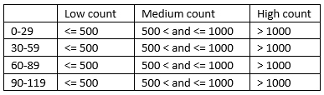
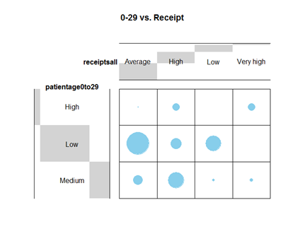
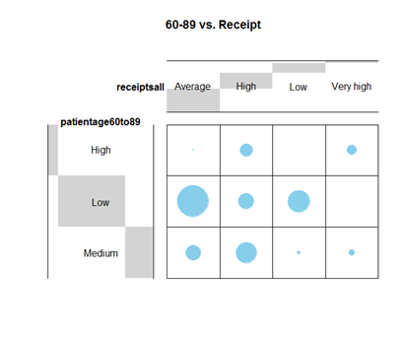
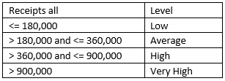
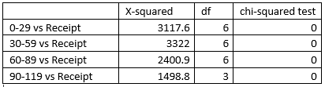
Correspondence Analysis
Using balloonplot() from gplots package, we found:
Grouping Ages
Grouping Total Receipts
Age groups 0-29 and 60-89 are very similar in terms of their correlations between number of patients and total receipt of an eye care practice.
There are many optometry practices that have under 500 patients aged between 0-29 or 60-89. Additionally, total receipts collected from these patients tend to be between $180,000 - $360,000, which is an Average amount.
Chi-squared tests for each CA

Slide 7
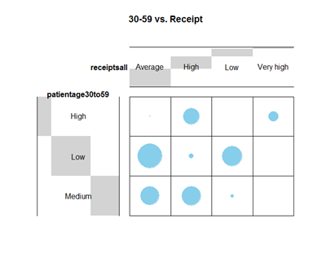
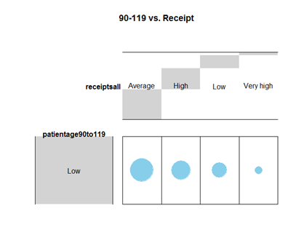
Correspondence Analysis
Using balloonplot() from gplots package, we found:
An optometry practice that has a Low number of patients (aged 30-59) is much less likely to have a High total quarterly receipt ($360,000 - $900,000).
However, this age group has the strongest correlation between High number of patients and High total receipt, compared to other age groups.
All practices have under 500 patients aged 90-119.
90-119 is the only age group that has correlation between Low number of patients and Very High total receipt, even though it is not a strong correlation.

Slide 8
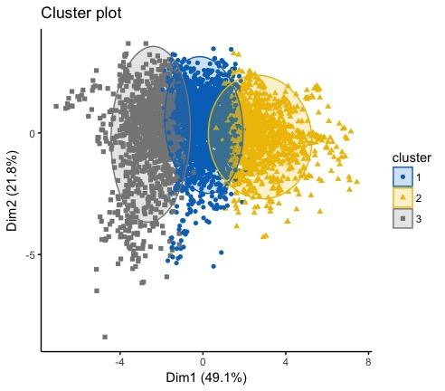
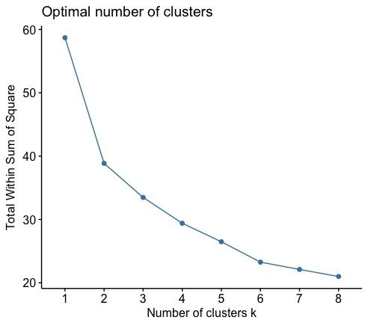
Cluster Analysis
Original Age Variables:
0-9
10-19
20-29
30-39
40-49
50-59
60-69
70-79
80-89
90-99
K = 3

Slide 9
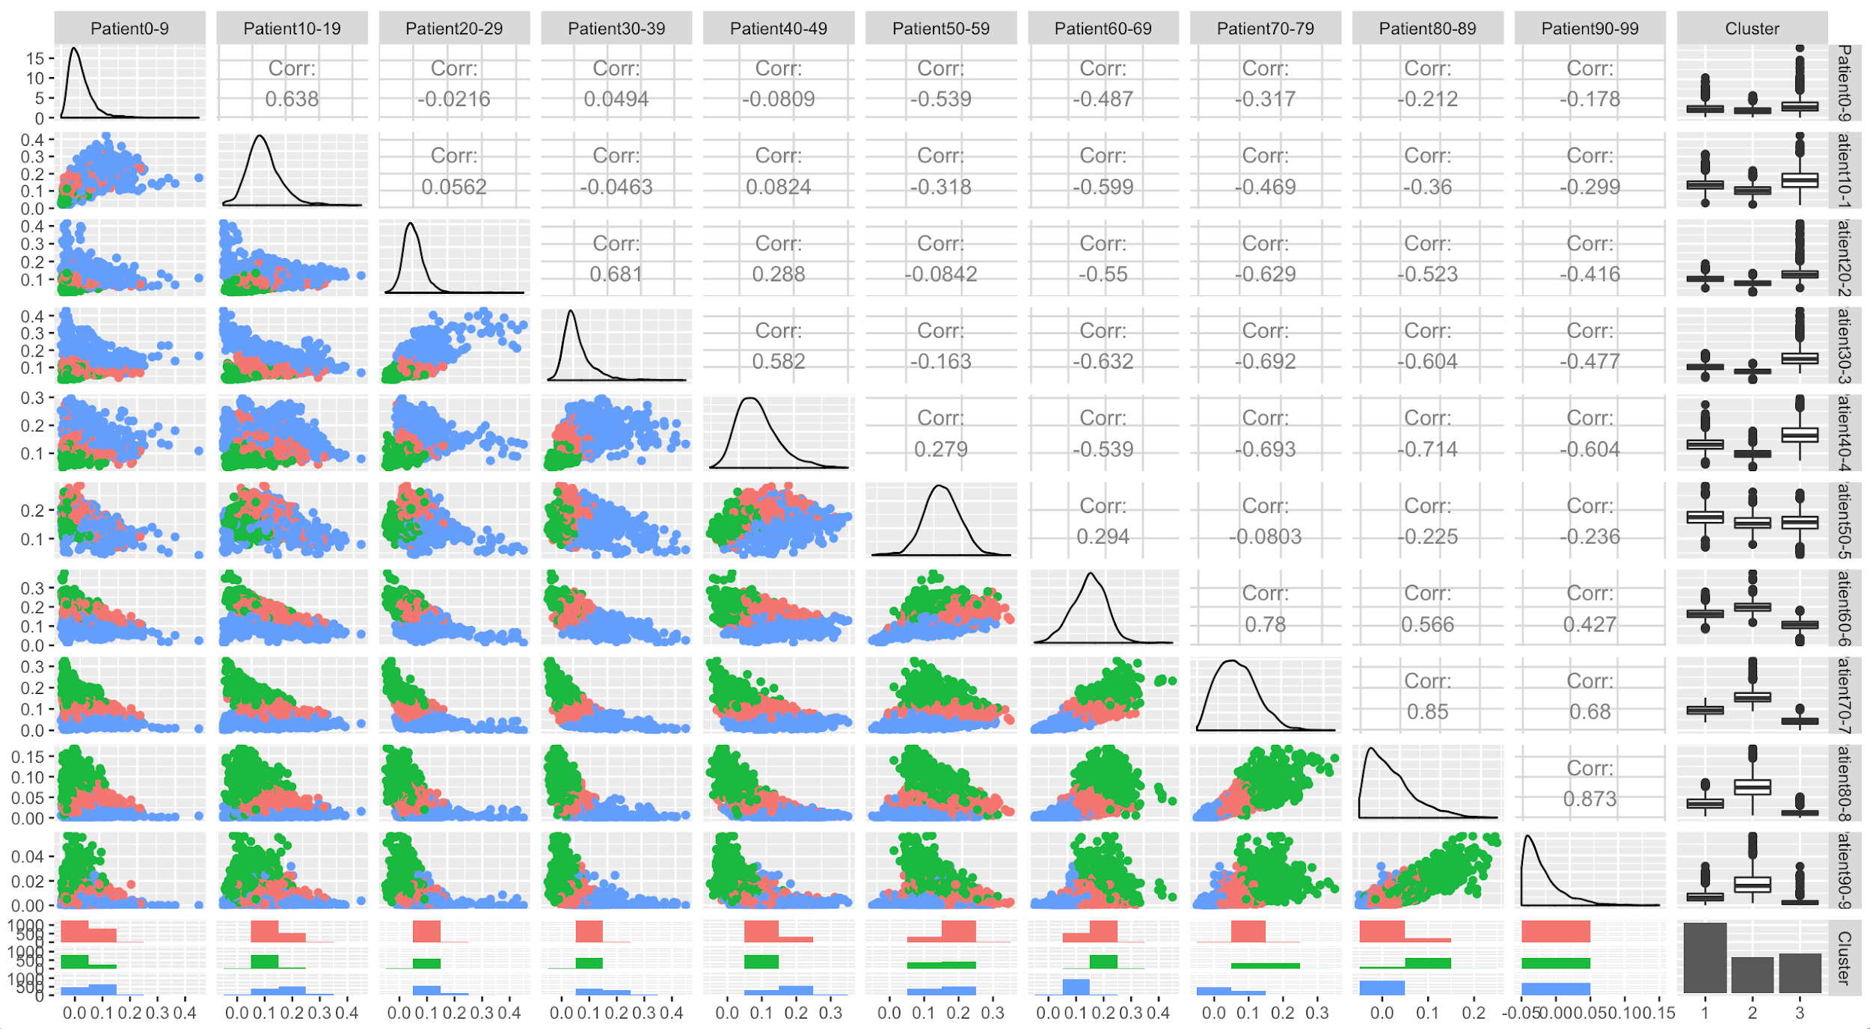
Cluster Analysis
Cluster 1: Balance Age - The practices do not have a skewed population of patients’ age
Cluster 2: Old Patients - The practices have a population of patients that are skewed toward young age
Cluster 3: Young Patients - The practices have a population of patients that are skewed toward old age

Slide 10
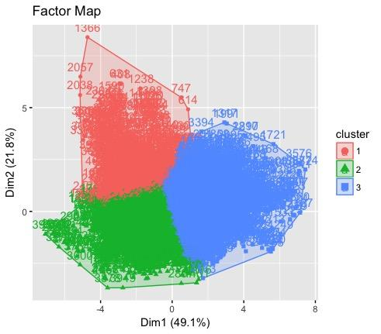
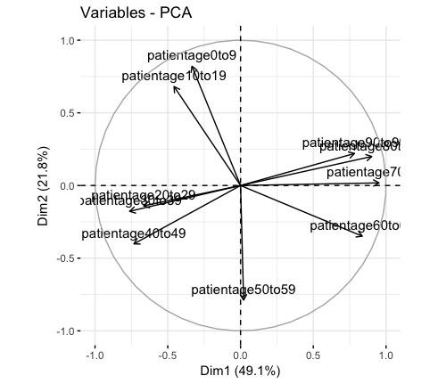
Hierarchical Clustering on Principal Component
Cutting tree
K = 4 (Recommended)
Notes:
Using PCA analysis

Slide 11
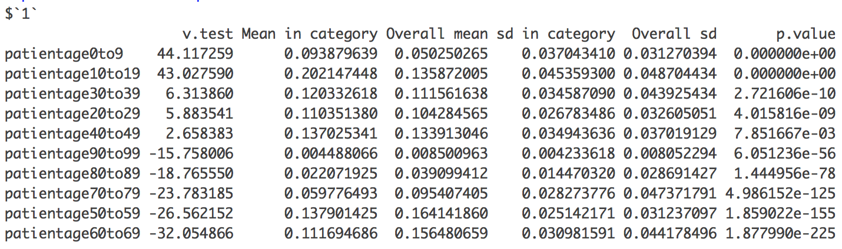
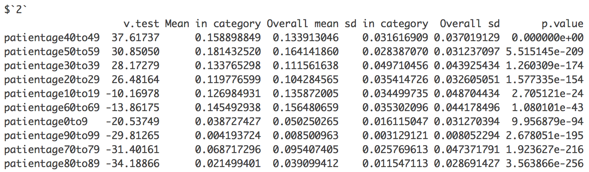
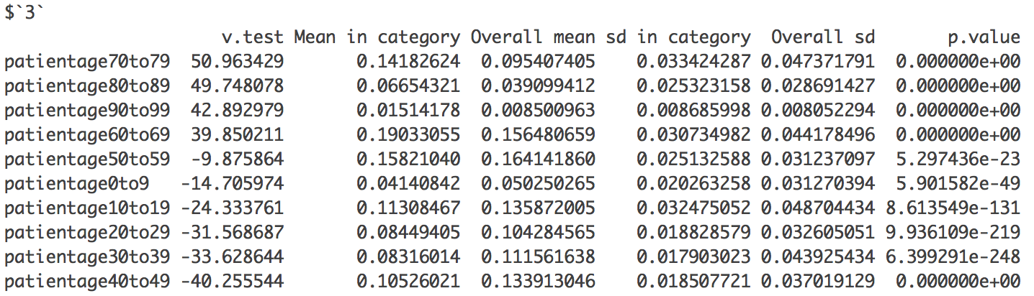
Cluster 1: associate with Patient aged 0-19 (Young Aged Group)
Cluster 2: associate with patient aged 20-59 (Balance Aged Group)
Cluster 3: associate with patient aged 60-99 (Old Aged Group)

Slide 12
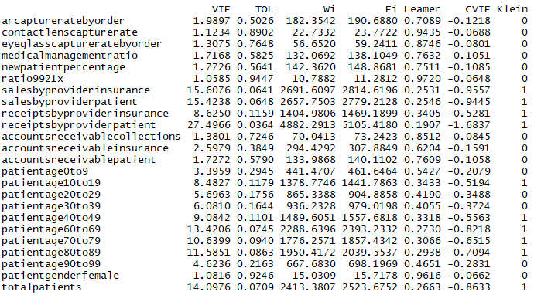
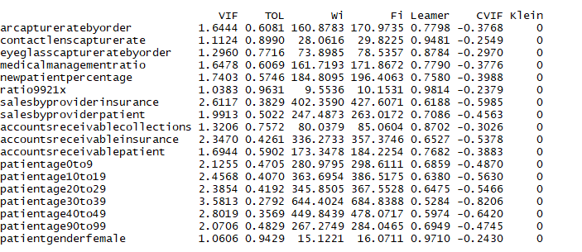
Principal Component Analysis
As in the real world it is expensive to use many variables in the data, we performed PCA to reduce the dimensions with good interpretations and latent factor detection is used for latter to find the driving factors for the components.
VIF is checked for multicollinearity and the variables with VIF greater than 5 are removed.
VIF of the Initial Subset
Final list of the variables VIF after those with high VIF are taken out.

Slide 13
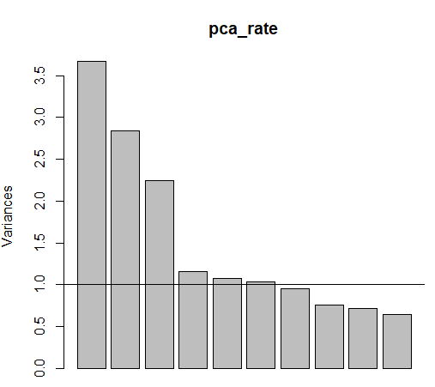
PCA Assumptions
Data sample is tested by using KMO which returns MSA = 0.71.
Normality in the data is obtained by doing Log Transformation.
Linearity is checked by using Mcortest.
Factorability is tested by using Bartlett test whose P-value = 0, which indicates the data is statistically significant to interpret the components.
Interpretation is Key to determine the best no. of components in either of Kaiser and Scree Plot methods.

Slide 14
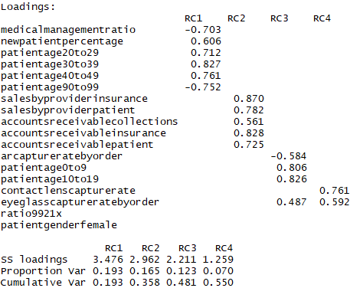
Naming the Components
Among various results PCA with 4 components gives good results in terms of interpretations explaining 55% variance in the data.
Adults = -0.7 (MedicalManagementratio) + 0.6 (newpatientpercentage) + 0.7 (patientage20to29) + 0.8 (patientage30to39) + 0.76 (patientage40to49) - 0.75 (patientage90to99)
AR and Sales = 0.87(salesbyproviderinsurance) + 0.78(salesbyproviderpatient) + 0.56 (accountsreceivablecollection) + 0.83 (accountsreceivableinsurance) + 0.73 (accountsreceivablepatient)
Youth = -0.6 (arcapturebyorder) + 0.8 (patientage0to9) + (patientage10to19)
Capturerates = 0.76 (contactlenscapturerate) + 0.6 (eyeglasscapturertebyorder)

Slide 15
Canonical Correlation Analysis
Independent Variables:
Medical Management Ratio
New Patient Ratio
Age 20-29 Ratio
Age 30-39 Ratio
Age 40-49 Ratio
Age 90-99 Ratio
Dependent Variables:
Contact Lens Capture Rate
Eyeglass Capture Rate
 | Correlation | F-Test | p-value
CV 1 | 0.298 | 43.3 | 0.000
CV 2 | 0.160 | 22.5 | 0.000

Slide 16
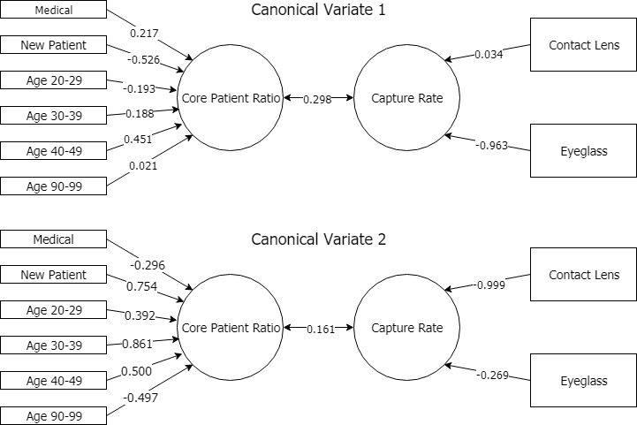
Graphical Depiction of Canonical Variates

Slide 17
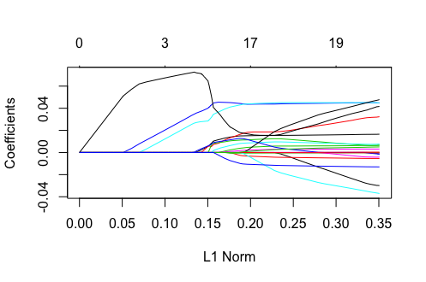
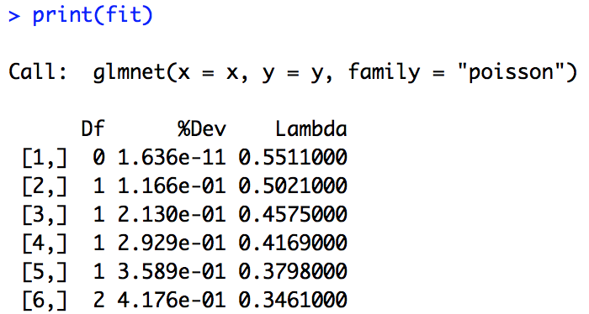
Regression Analysis
LASSO
Predict eye glasses capture rate
(w/ patient demographics, clinical details, revenue details - 23 predictors)
Subset data for CountPerformance
4298 Obs - 80/20 split
Log transform each variable
Poisson family
P-value 0.02 (Package RPtest)
10-fold Cross-validation
Summary of the glmnet path at each step:

Slide 18
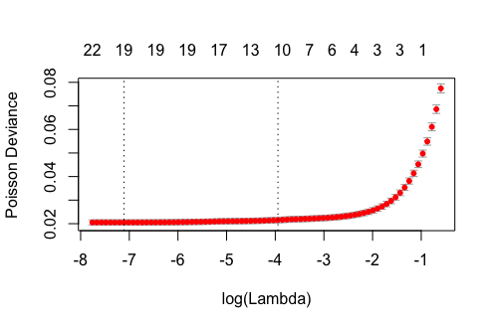
Regression Analysis (cont’d)
Selected variables (10 from 23):
1.204377e-02 * (NewPatientNumber) + 4.543061e-02 *(Age10-19) + 3.750349e-02 *(Age 20-29) + 9.244941e-03*(Age 50-59) + 9.168723e-03 *(Age 60-69) + 4.149451e-03 *(Age 80-89) + 1.273625e-05 *(Age 90-99) + 3.355240e-02 *(Female) + 1.008777e-02 *(SalesByInsurance) -3.335736e-03 * (AccountsReceiviblePatient) = LogEyeGlassesCapptureRate
LASSO cross-validation
-- measurement: MSE
Cross-validation Curve
Prediction Error - 80/20 Training & Validation
λ | RSE
.004416 | .01810307
min | .01781806
Log λ min
Log λ 1se

Slide 19
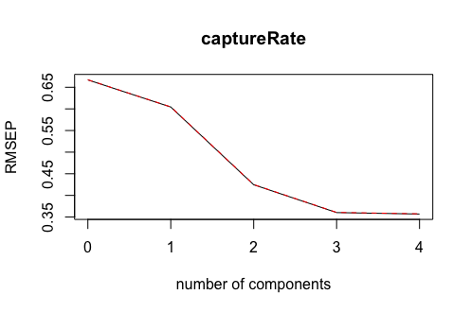
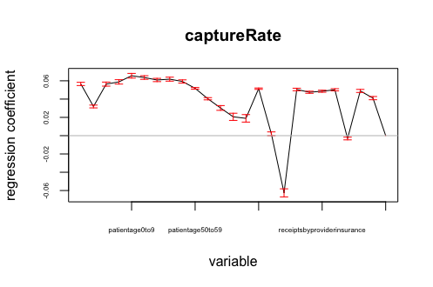
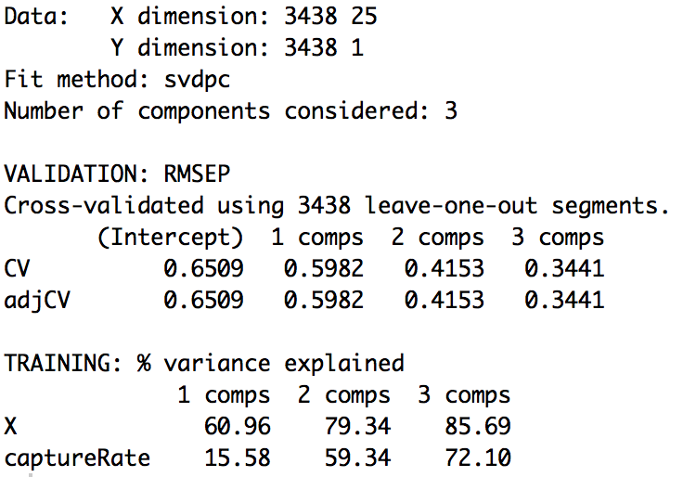
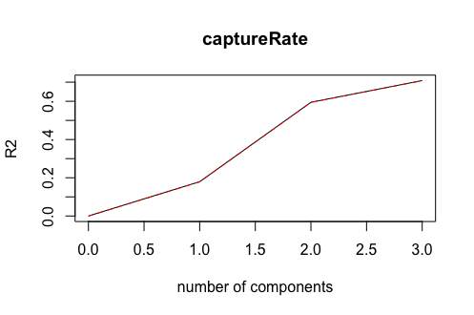
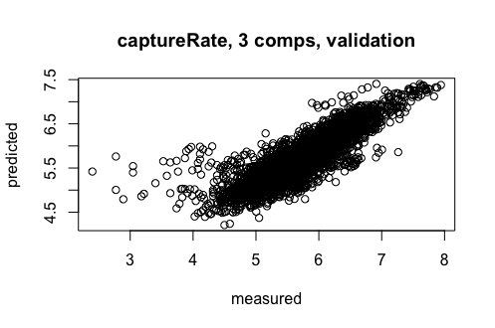
Regression Analysis 2. PCR
Determine no. of components
Check model fitting
Summary for PCR w/cv
Root Mean Square Error of Prediction (RMSEP)
0.01310407

Slide 20
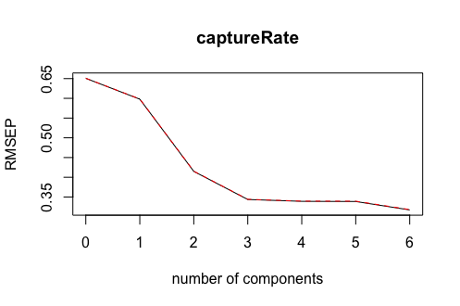
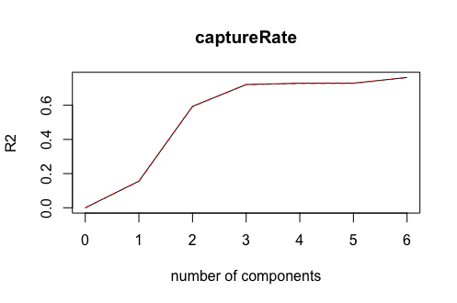
2. PCR What about 6 Components ?
Summary for PCR w/cv

Slide 21
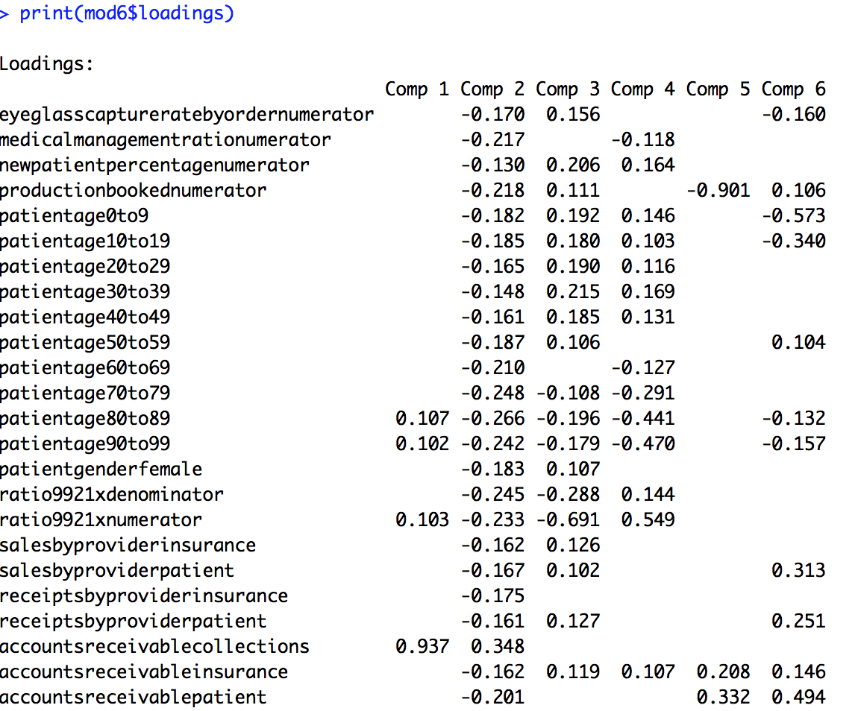
Loadings for 6 Components
Loadings of 6 components
Less confusing than 3 or 4 components
Still hard to interpret
Results of PCR: not ideal

Slide 22
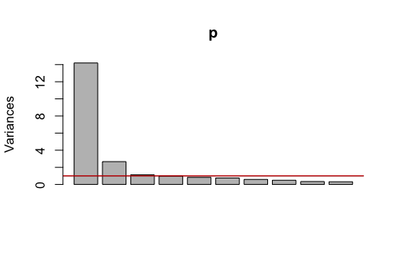
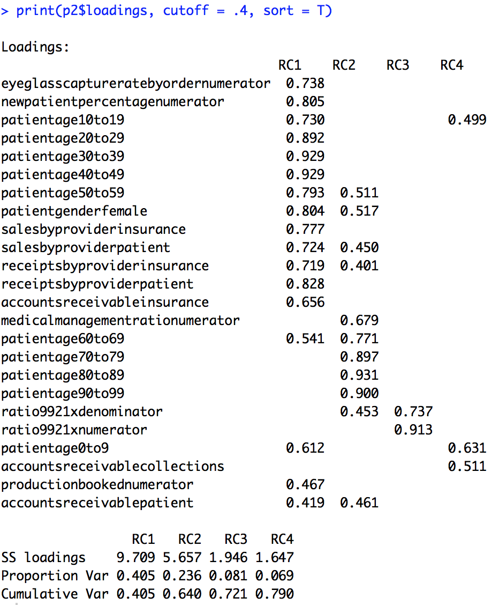
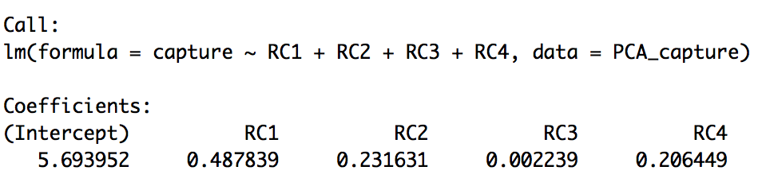
Multiple Regression With Principal Components

Slide 23
Limitations
Some data was removed so it would be available, notably practice identifiers and quarter time period.
Each observation was an aggregation of thousands of events.
Lack of selection criteria resulted in significant outliers.
Lack of information on Eye Care practices for each quarter.
Future Research Opportunities
Include data removed and additional information about the locations, providers, and employees of the practices.
Combine with Clinical Quality Measures summary data on patient population.

Slide 24
Conclusion
Our data exploration broke the patient demographics down into concise components and clusters.
A prediction of the eyeglass capture rate is positively influenced by patients who are new, young, and female. It is negatively influenced by the level of accounts receivable at the practice.
The combined capture rates, eyeglass and contact lens, are not highly correlated with the Adult component which accounts for the most variance in our observations.

Slide 25
References and Literature Reviews
U.S. Department of Health and Human Services (2017). Health, United States, 2016: With Chartbook on Long-term Trends in Health. Hyattsville, MD. 2017
Fylan, F., Grunfeld, E., Turvey, A., and Desallais, J. (2004) Four different types of client attitudes towards purchasing spectacles in optometric practices.
American Optometric Association. (2011). Practical hints on meaningful use. Optometry-Journal of the American Optometric Association, 82(12), 757-765.
Gerber, G. (2013). Essential elements of tracking practice performance: these key metrics can reveal areas of concern--and opportunity--to assist in strategic planning. Review of Optometry, 150(10), 74-82.
Miller, R. H., West, C., Brown, T. M., Sim, I., & Ganchoff, C. (2005). The value of electronic health records in solo or small group practices. Health Affairs, 24(5), 1127-1137.
Soroka, M., Krumholz, D., & Bennett, A. (2006). The practice of optometry: National Board of Examiners in Optometry survey of optometric patients. Optometry-Journal of the American Optometric Association, 77(9), 427-437.

